Slide 1

GHOST in the Model
AI-Assisted Threat Models for Efficient Offensive Security Testing
Sam Cosentino

Slide 2


Agenda
Introduction
Humanity & LLMs
Traditional Threat Modeling
LLM Threat Modeling
Threat Modeling with Online LLM
Offline LLM Threat Modeling Setup
Threat Modeling with Offline LLM
Contributions & Gratitude
Q&A

Slide 3


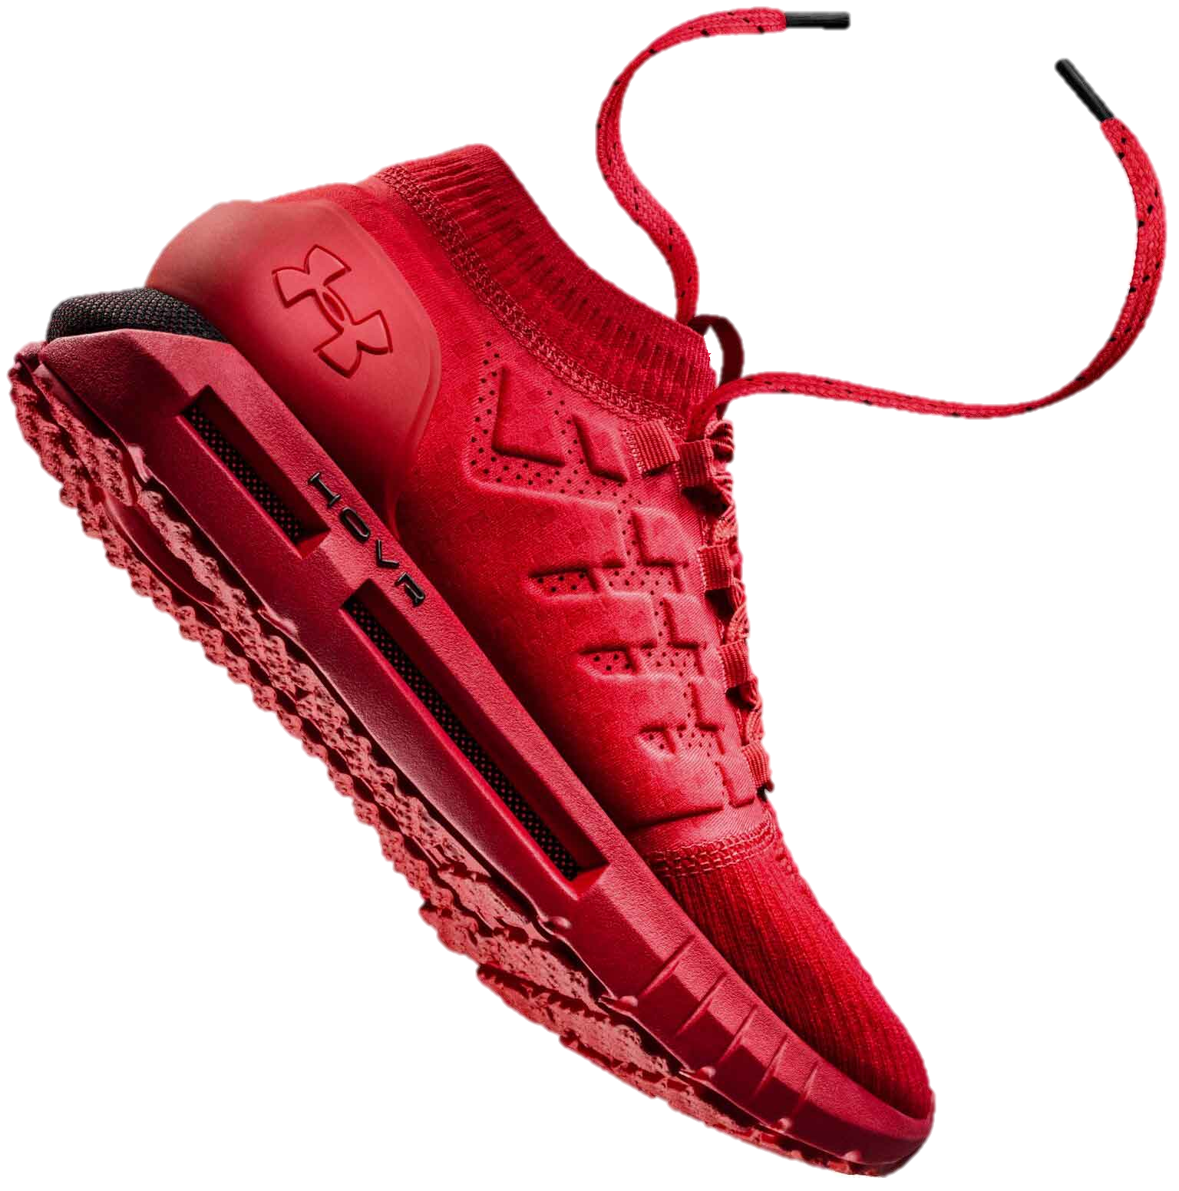



Dir(me)

Slide 4


TL;DR
AI…
Won’t take your job
Improves your results
takes time to train
CAN BE expensive

Slide 5

objective
Leverage ai to identify test cases for red teaming & pen testing to:
keyboard time
assessment efficiency
test case coverage
tunnel vision
planning time

Slide 6


AUDIENCE
Red Teamer
Pen tester
App sec
engineer
Security
engineer
Software engineer

Slide 7




What do we [humans] do well?
IMAGINATION
Context
Intuition
Critical Thinking

Slide 8









Large Language Models
Online / Public
Offline / Private
Notes:
Why you chose model; ChatGPT & Ollama (best performant)
Mention Bard, Gemini, etc.
Compare & contrast paid & private
Google Bard
GitHub/Microsoft CoPilot
Google PaLM

Slide 9


HOW CAN AI HELP?
Speed
Efficiency
Automation
Complex Data
Patterns
Notes:
More Ghost in the Shell images, less others
Section 6 Chief
Batou
Motoko connected to Interfaces
Fuchikomo
Laughing Man

Slide 10

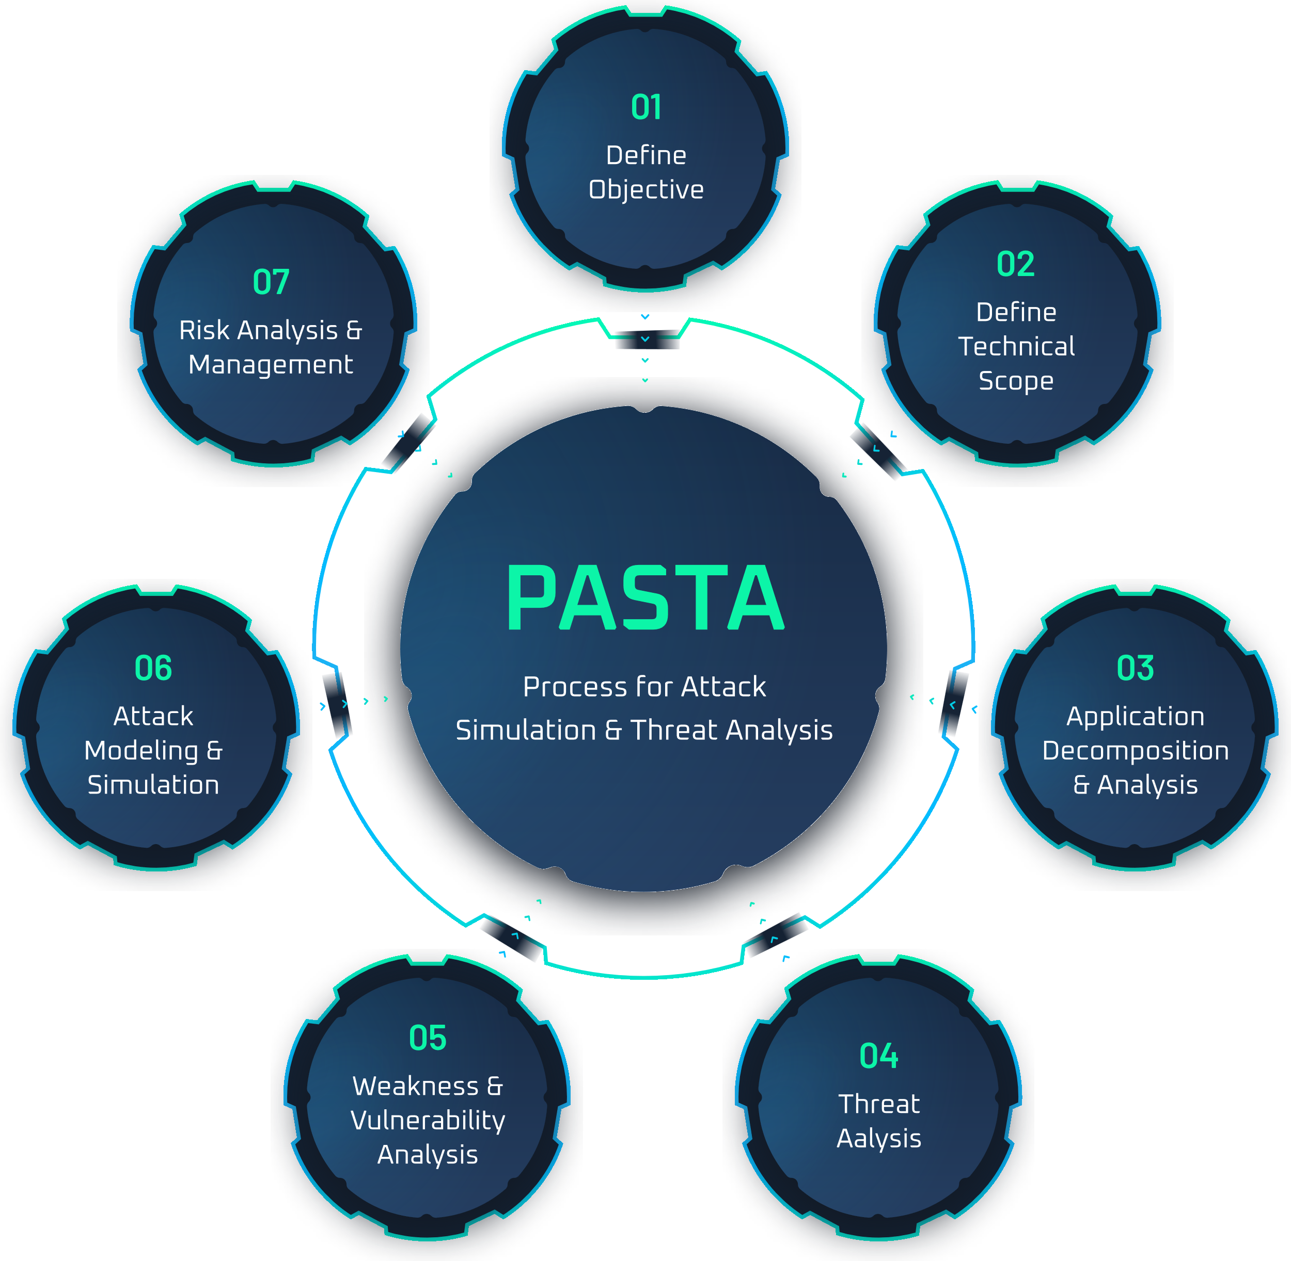
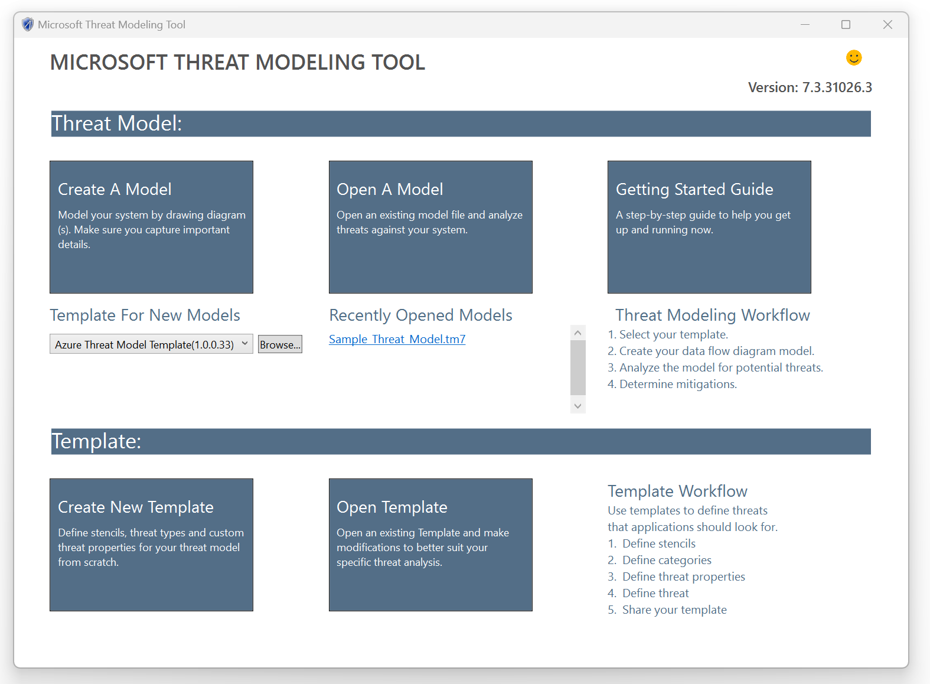
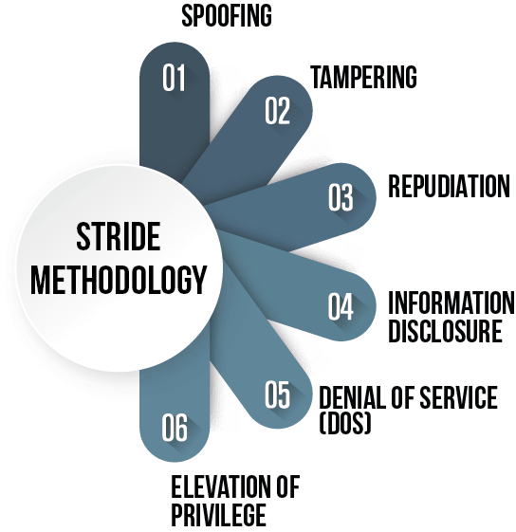
Threat modeling

Slide 11


Threat Modeling… why & WHY NOT?
BENEFITS | LIMITATIONS
SECURE DESIGN | MANUAL EFFORT
REDUCED DEFECT COST | CAN BE COMPLEX
RISK MEASUREMENT | LIMITED AUTOMATION
IMPROVED TESTING | NO STANDARDIZATION

Slide 12

Threat Modeling + LLMs
Accelerate Junior Engineer Impact
Efficient Security Assessment Testing
Assurance of Test Coverage
More Time Testing, Less Time Planning
Input Options
Text
Architecture Diagrams
Swagger Docs

Slide 13
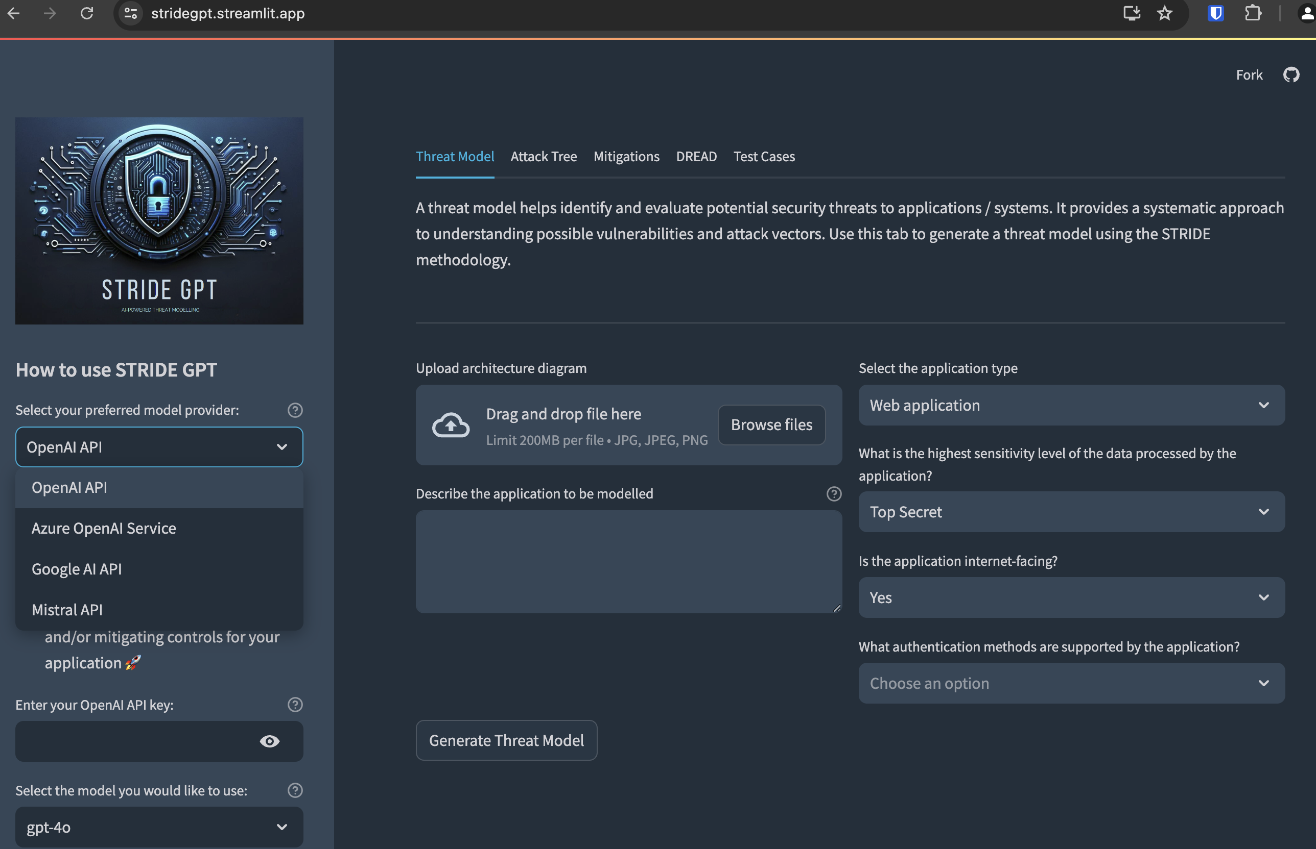
stridegpt
Text
Text
Text
Text

Slide 14
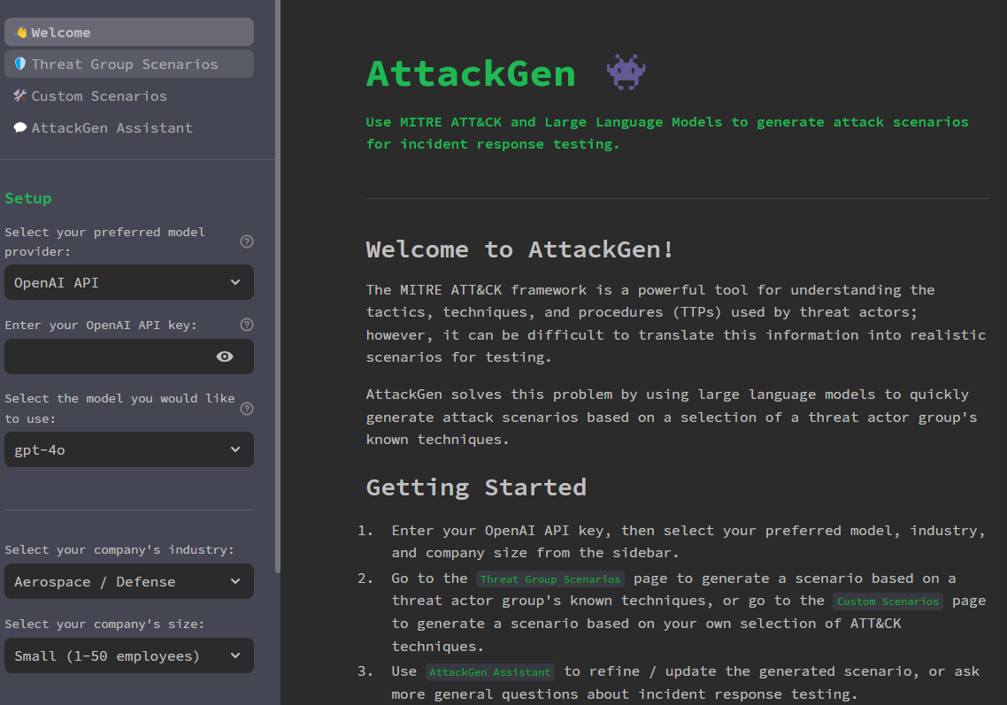
stridegpt
Text
Text
Text
Text

Slide 15


CAUTION
Careless use of LLMs for Threat Modeling can be hazardous to your security health
Dangers
Leakage
Hallucations
Misinterpretation
Privacy
Bias
Security
Private/Offline LLM Usage
Re-Weighting
Output SME Review
Anonymization & Data Masking
Continuous Training
Notes:
May not add anything, potentially remove

Slide 16

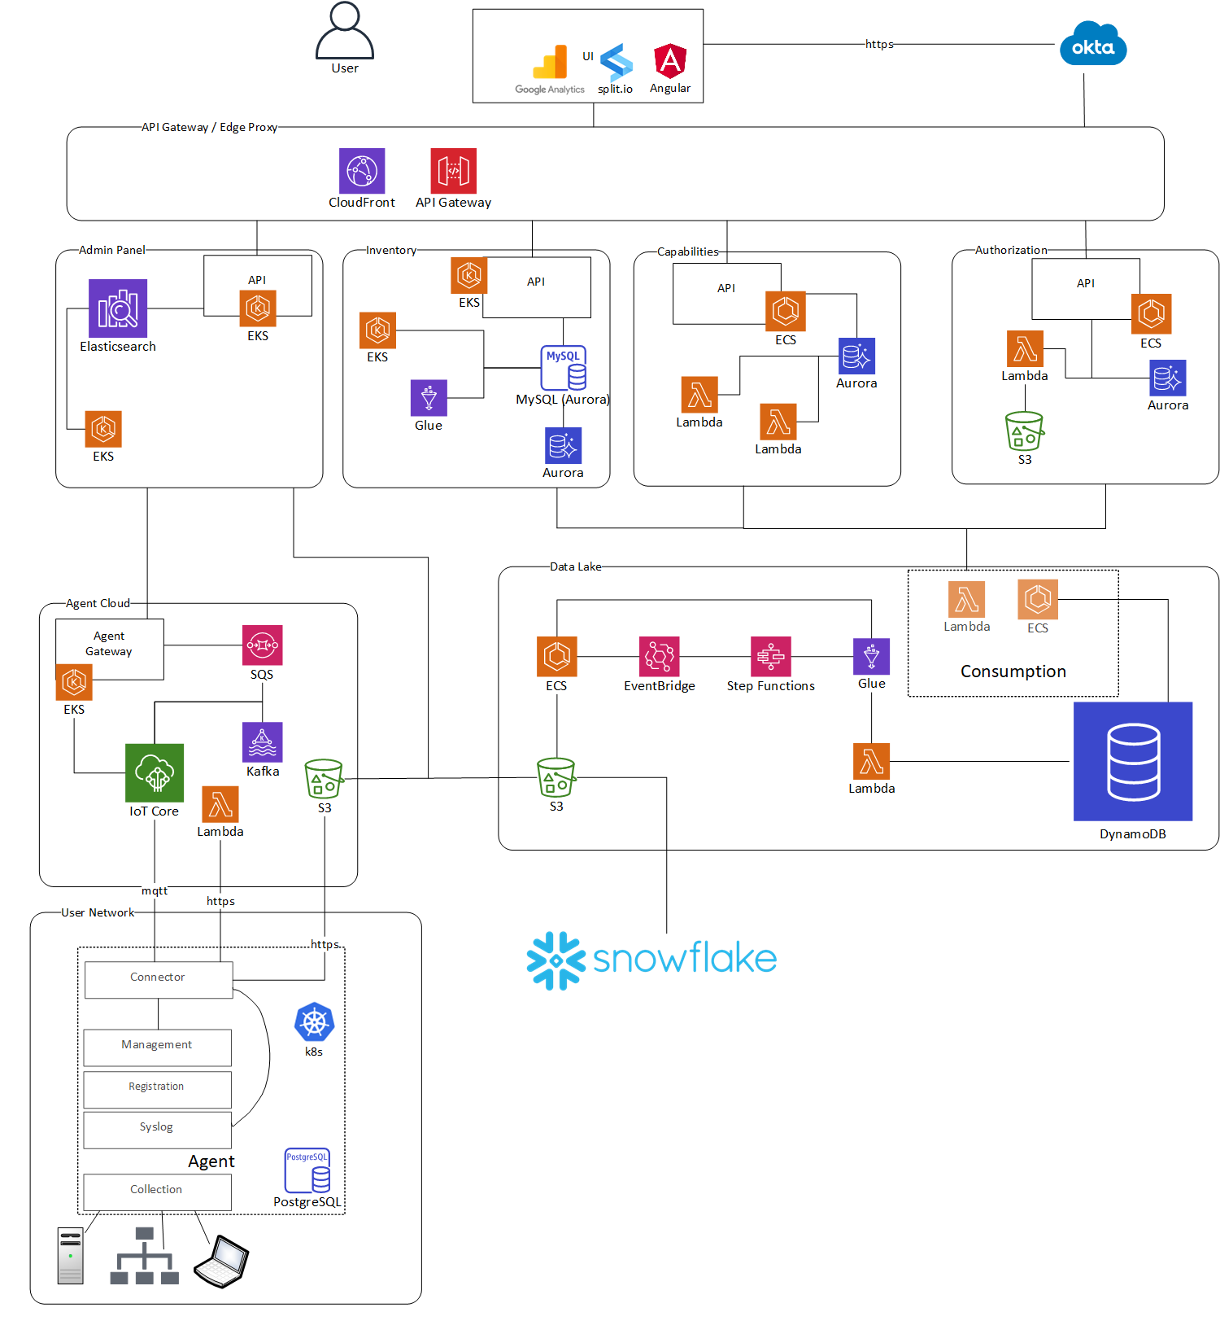
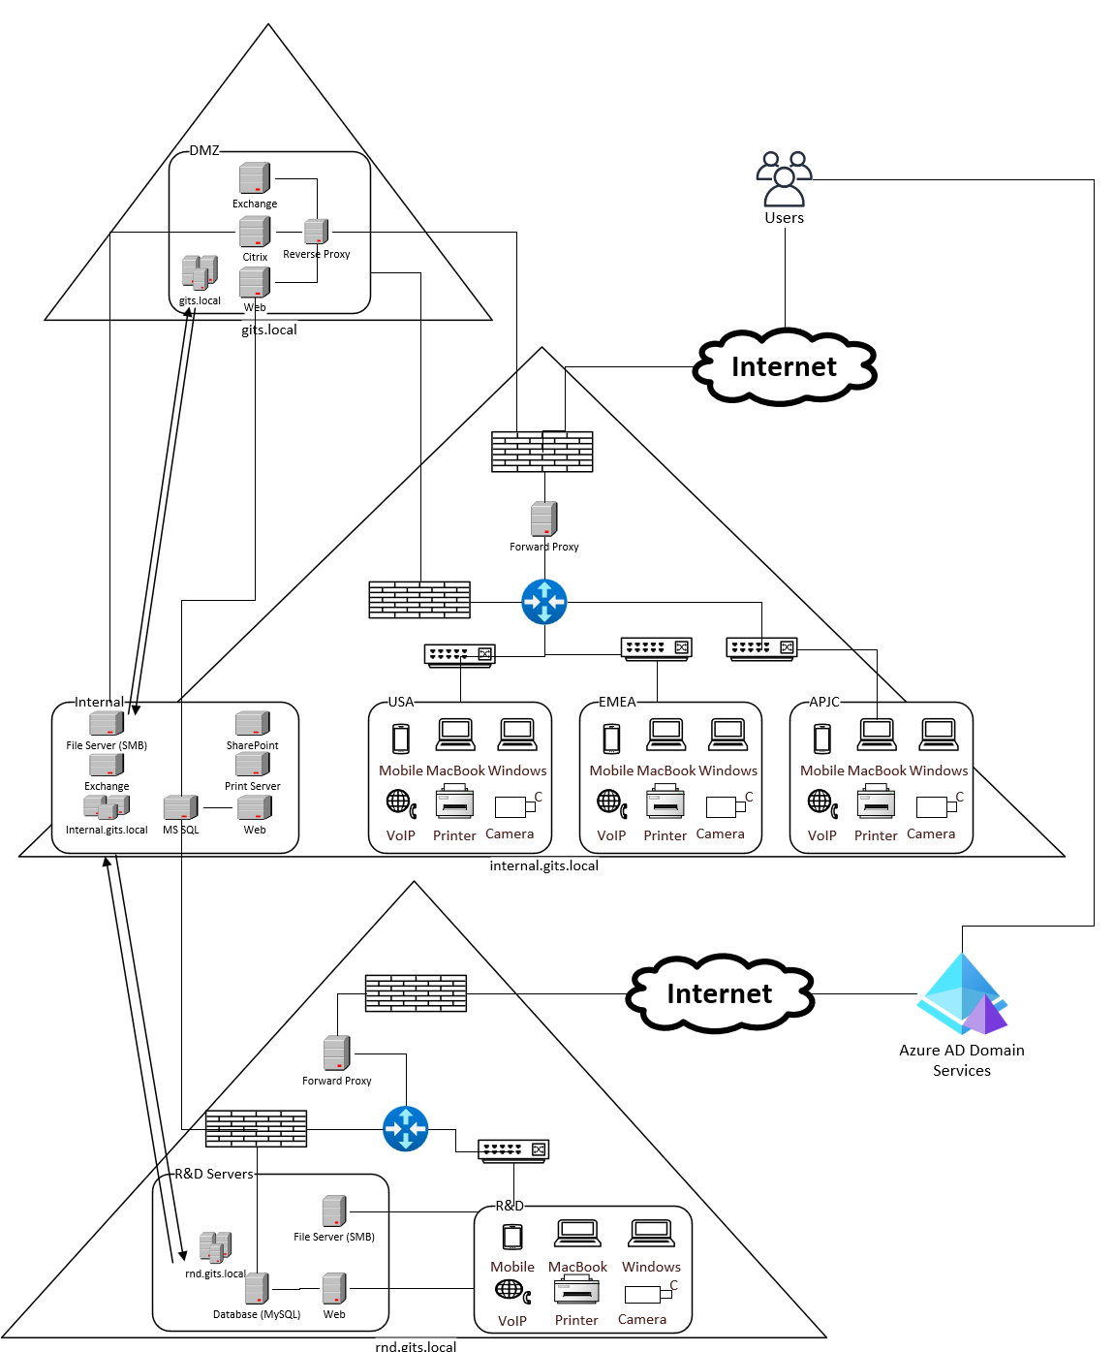
Architecture diagrams

Slide 17

Threat Modeling with Online LLM
4o

Slide 18

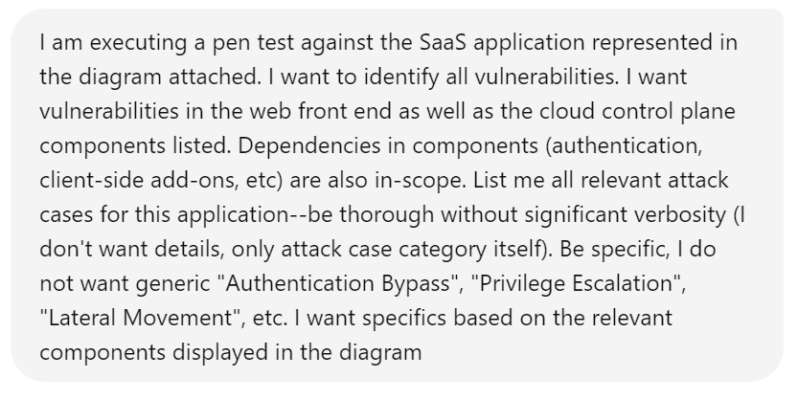
Pen Test Modeling: Prompt
Notes:
I am executing a pen test against the SaaS application represented in the diagram attached. I want to identify all vulnerabilities. I want vulnerabilities in the web front end as well as the cloud control plane components listed. Dependencies in components (authentication, client-side add-ons, etc) are also in-scope. List me all relevant attack cases for this application--be thorough without significant verbosity (I don't want details, only attack case category itself). Be specific, I do not want generic "Authentication Bypass", "Privilege Escalation", "Lateral Movement", etc. I want specifics based on the relevant components displayed in the diagram

Slide 19
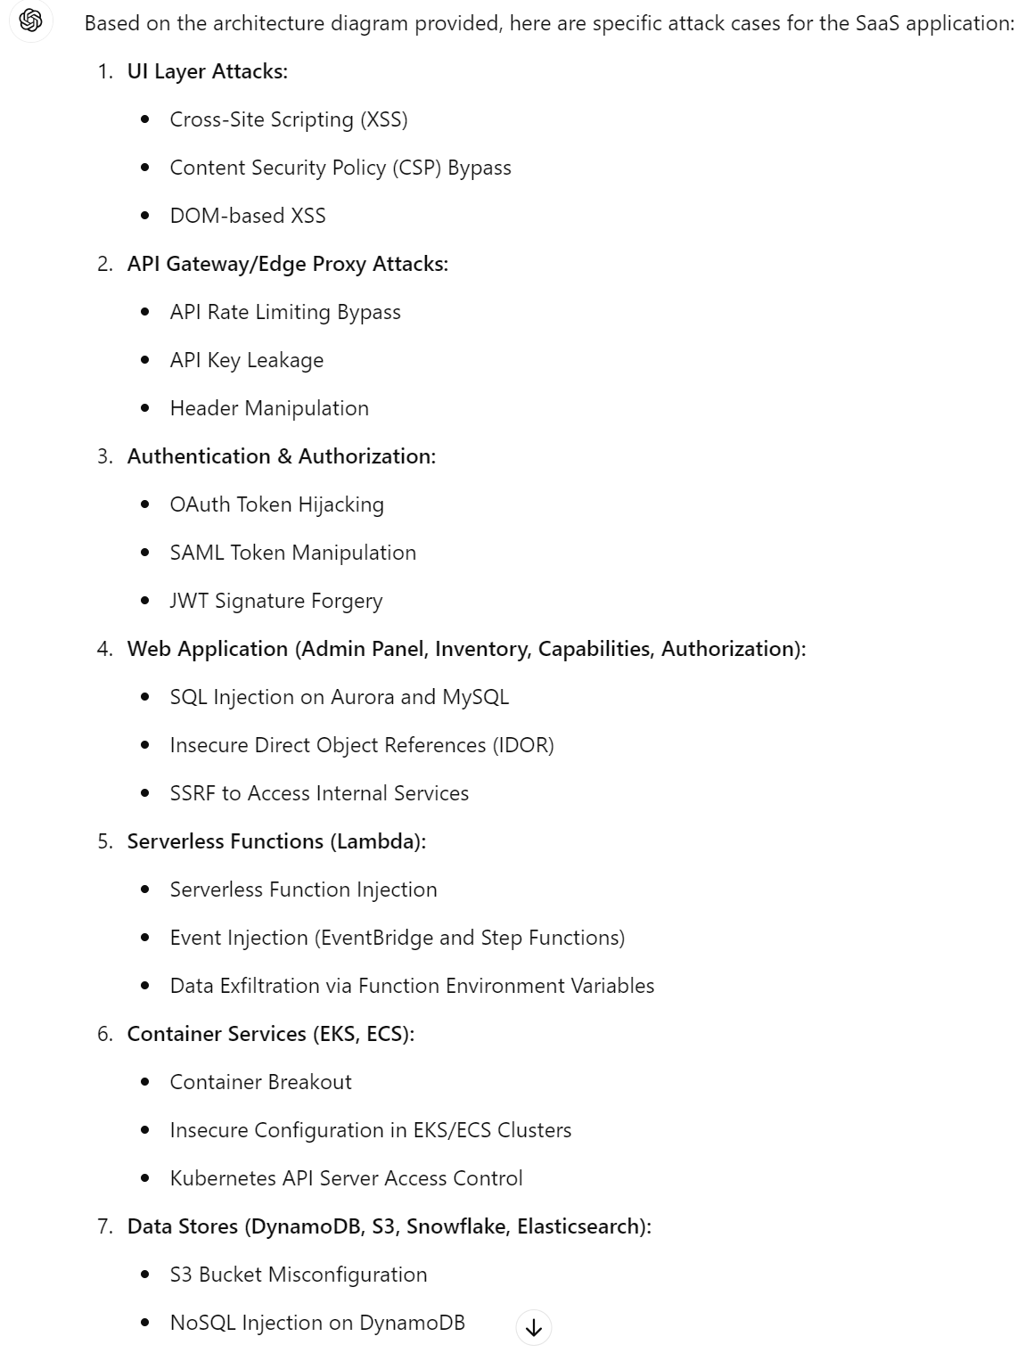
Pen Test Modeling: RESULTS (1)

Slide 20
Pen Test Modeling: RESULTS (2)

Slide 21
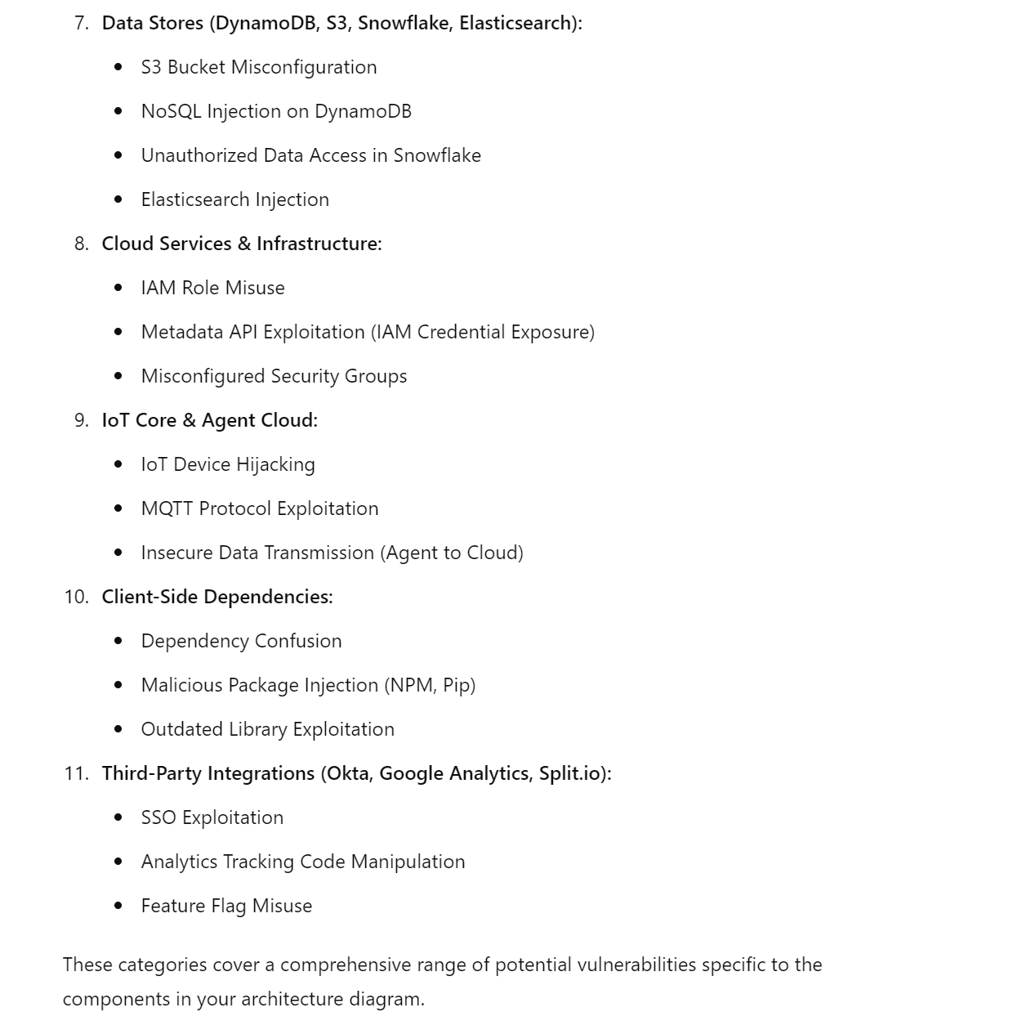
Pen Test Modeling: RESULTS (3)

Slide 22
Pen Test Modeling: RESULTS (4)

Slide 23
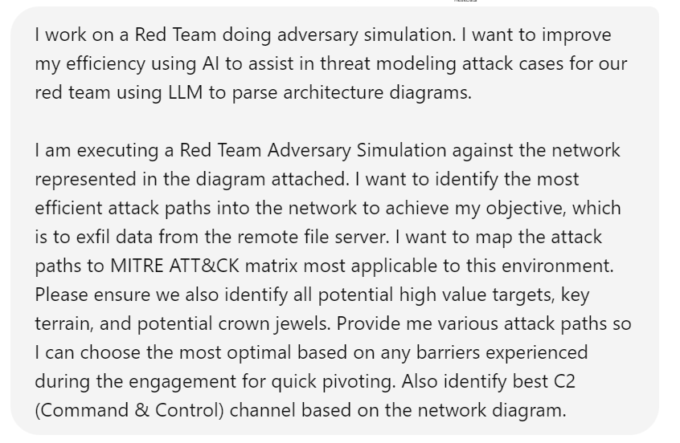
RED TEAM MODELING: PROMPT
RED TEAM PROMPT
Notes:
I am executing a Red Team Adversary Simulation against the network represented in the diagram attached. I want to identify the most efficient attack paths into the network to achieve my objective, which is to exfil data from the remote file server. I want to map the attack paths to MITRE ATT&CK matrix most applicable to this environment. Please ensure we also identify all potential high value targets, key terrain, and potential crown jewels. Provide me various attack paths so I can choose the most optimal based on any barriers experienced during the engagement for quick pivoting. Also identify best C2 (Command & Control) channel based on the network diagram.
Be also useful for Blue Teamers to run proactively pre-engagement
I work on a Red Team doing adversary simulation. I want to improve my efficiency using AI to assist in threat modeling attack cases for our red team using LLM to parse architecture diagrams.

Slide 24
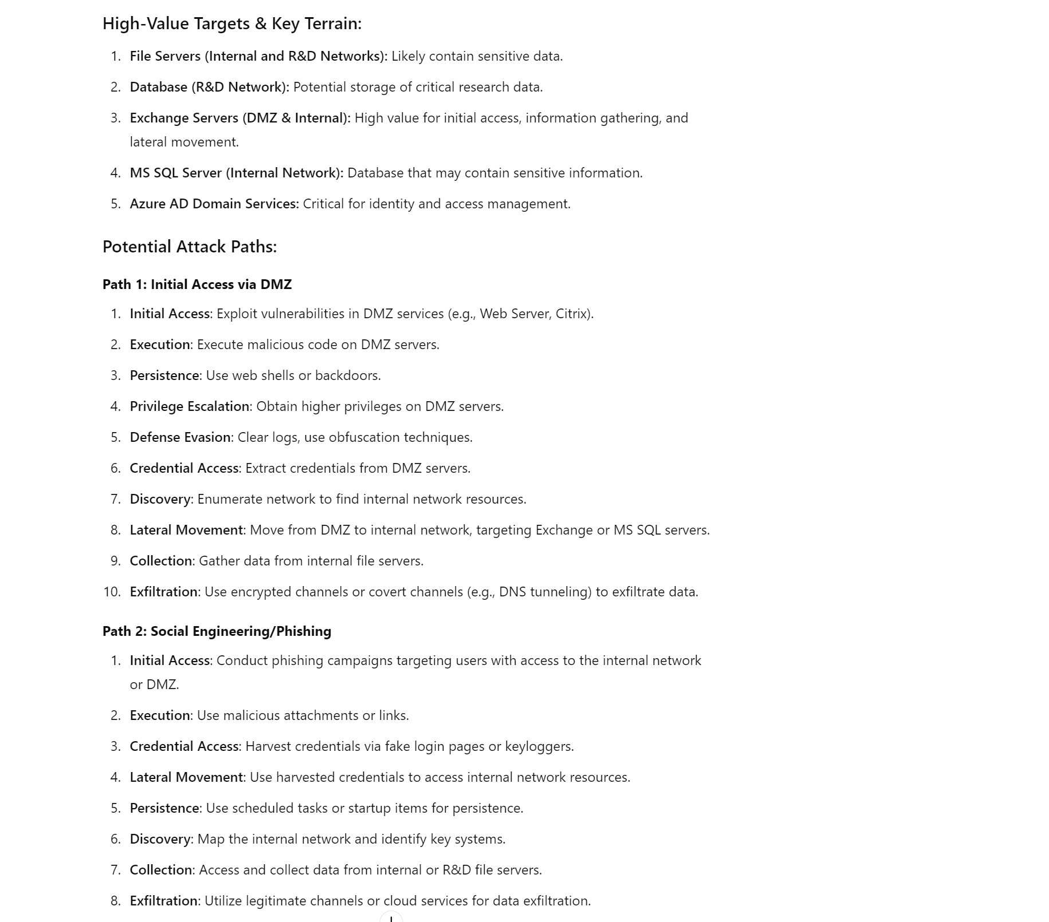
RED TEAM MODELING: Results (1)

Slide 25
RED TEAM MODELING: Results (2)

Slide 26
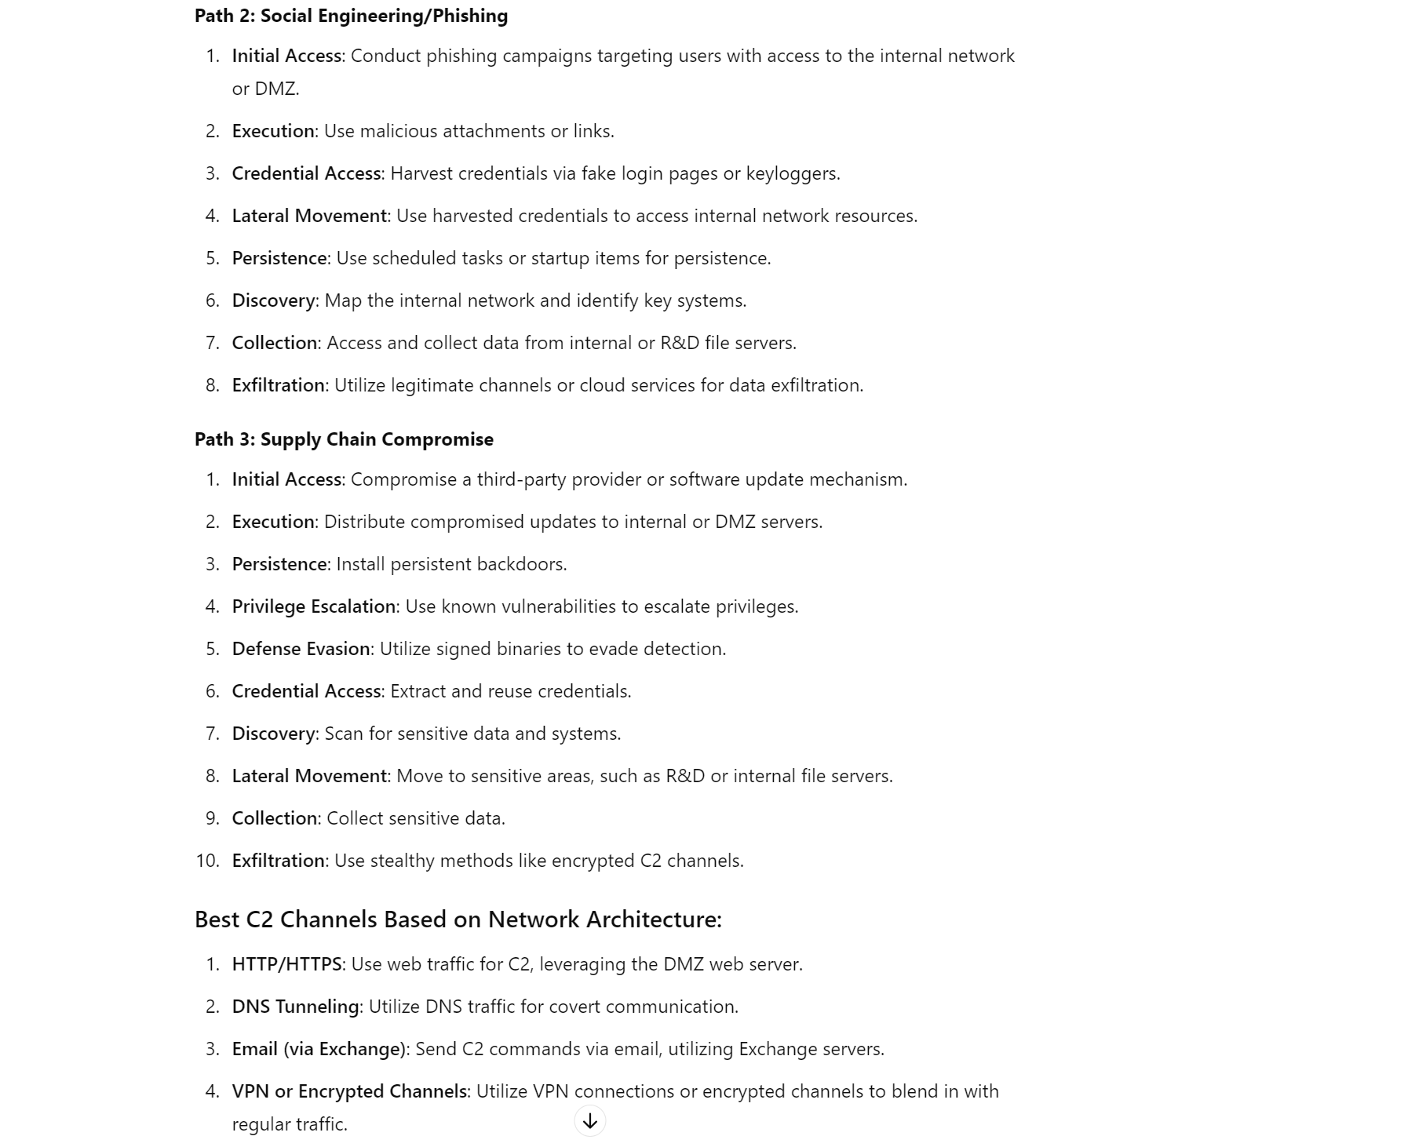
RED TEAM MODELING: Results (3)

Slide 27
RED TEAM MODELING: Results (4)

Slide 28
Offline LLM Threat Modeling Setup

Slide 29



LLava: PoC HARDWARE (GCP)
Category | Hardware | # | Monthly Cost (USD)
Machine Type | n1-standard-4 | 1 | $34.58
CPU | 4 Core | 1
RAM | 15GB | 1
GPU | NVidia T4 | 1 | $102.20
Storage | 250GB | 1 | $8.80
$145.58/month

Slide 30
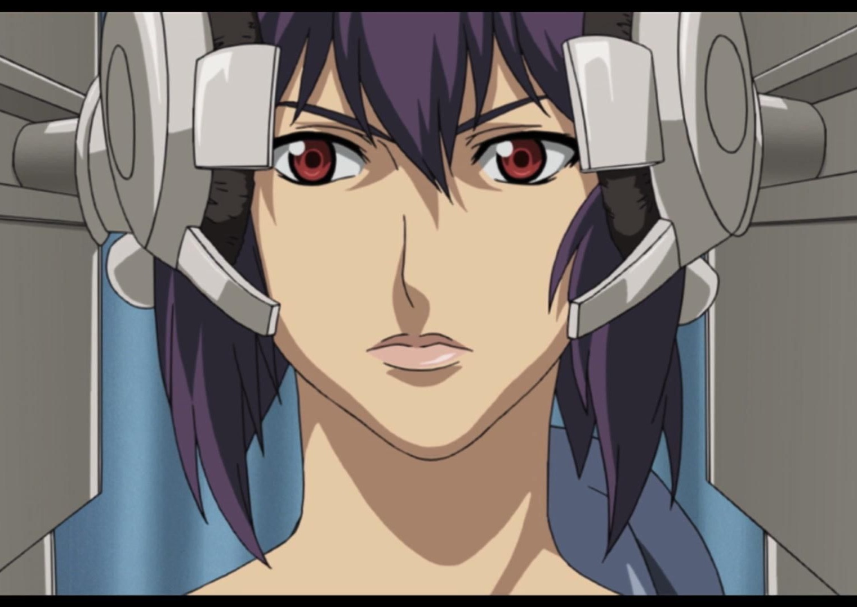
LLava: PoC Software & Models
Software Dependencies
OS (Ubuntu)
Docker + GPU Support
Python3
CUDA Drivers
Open WebUI
NGINX
Models
LLaVa 13B or 34B
Ollama

Slide 31


LLava: Setup PREREQUISITES
sudo apt-get update
sudo apt-get install -y build-essential dkms curl gnupg2 software-properties-common nginx
wget https://developer.download.nvidia.com/compute/cuda/repos/ubuntu2004/x86_64/cuda-ubuntu2004.pin
sudo mv cuda-ubuntu2004.pin /etc/apt/preferences.d/cuda-repository-pin-600
wget https://developer.download.nvidia.com/compute/cuda/11.4.1/local_installers/cuda-repo-ubuntu2004-11-4-local_11.4.1-470.57.02-1_amd64.deb
sudo dpkg -i cuda-repo-ubuntu2004-11-4-local_11.4.1-470.57.02-1_amd64.deb
sudo apt-key add /var/cuda-repo-ubuntu2004-11-4-local/7fa2af80.pub
sudo apt-get update
sudo apt-get install -y cuda docker.io nvidia-docker2
sudo reboot
nvidia-smi
sudo docker run --rm --gpus all nvidia/cuda:11.0-base nvidia-smi
curl -fsSL https://ollama.com/install.sh | sh
ollama --version
sudo systemctl edit llama.service
sudo systemctl daemon-reload
sudo systemctl restart llama
ollama run --model-path /path/to/llava/model
Notes:
# 2 - Install Prerequisites (CUDA Drivers, Docker, etc.)
sudo apt-get update
sudo apt-get install -y build-essential dkms curl gnupg2 software-properties-common nginx
wget https://developer.download.nvidia.com/compute/cuda/repos/ubuntu2004/x86_64/cuda-ubuntu2004.pin
sudo mv cuda-ubuntu2004.pin /etc/apt/preferences.d/cuda-repository-pin-600
wget https://developer.download.nvidia.com/compute/cuda/11.4.1/local_installers/cuda-repo-ubuntu2004-11-4-local_11.4.1-470.57.02-1_amd64.deb
sudo dpkg -i cuda-repo-ubuntu2004-11-4-local_11.4.1-470.57.02-1_amd64.deb
sudo apt-key add /var/cuda-repo-ubuntu2004-11-4-local/7fa2af80.pub
sudo apt-get update
sudo apt-get install -y cuda docker.io nvidia-docker2
sudo reboot
nvidia-smi
sudo docker run --rm --gpus all nvidia/cuda:11.0-base nvidia-smi
# 3 - Ollama
curl -fsSL https://ollama.com/install.sh | sh
ollama --version
sudo systemctl edit llama.service
sudo systemctl daemon-reload
sudo systemctl restart llama
ollama run --model-path /path/to/llava/model
# 4 - NGINX
sudo bash -c 'echo "
server {
listen 80;
server_name your.domain.com;
location / {
proxy_pass http://127.0.0.1:11434;
proxy_set_header Host \$host;
proxy_set_header X-Real-IP \$remote_addr;
proxy_set_header X-Forwarded-For \$proxy_add_x_forwarded_for;
proxy_set_header X-Forwarded-Proto \$scheme;
}
}
" > /etc/nginx/sites-available/default'
sudo systemctl enable nginx
sudo systemctl start nginx
sudo systemctl reload nginx
# 5 - WebUI Deployment
sudo docker run -d --network=host -v open-webui:/app/backend/data -e OLLAMA_BASE_URL=http://127.0.0.1:11434 --name open-webui --restart always ghcr.io/open-webui/open-webui:main

Slide 32
LLava: Setup NGINX & WebUI
sudo bash -c 'echo "
server {
listen 80;
server_name your.domain.com;
location / {
proxy_pass http://127.0.0.1:11434;
proxy_set_header Host \$host;
proxy_set_header X-Real-IP \$remote_addr;
proxy_set_header X-Forwarded-For \$proxy_add_x_forwarded_for;
proxy_set_header X-Forwarded-Proto \$scheme;
}
}
" > /etc/nginx/sites-available/default'
sudo systemctl enable nginx
sudo systemctl start nginx
sudo systemctl reload nginx sudo docker run -d --network=host -v open-webui:/app/backend/data -e OLLAMA_BASE_URL=http://127.0.0.1:11434 --name open-webui --restart always ghcr.io/open-webui/open-webui:main
Notes:
sudo bash -c 'echo "
server {
listen 80;
server_name your.domain.com;
location / {
proxy_pass http://127.0.0.1:11434;
proxy_set_header Host \$host;
proxy_set_header X-Real-IP \$remote_addr;
proxy_set_header X-Forwarded-For \$proxy_add_x_forwarded_for;
proxy_set_header X-Forwarded-Proto \$scheme;
}
}
" > /etc/nginx/sites-available/default'
sudo systemctl enable nginx
sudo systemctl start nginx
sudo systemctl reload nginx
# 5 - WebUI Deployment
sudo docker run -d --network=host -v open-webui:/app/backend/data -e OLLAMA_BASE_URL=http://127.0.0.1:11434 --name open-webui --restart always ghcr.io/open-webui/open-webui:main

Slide 33
LLava: Quantization
Low-precision parameter representations (> typical FP32) used to optimize model size & reduce computational requirements
BENEFITS | LIMITATIONS
Less UX Latency | Less Accurate
Cheaper | Less Precision (FP16, INT8, Q4_O)
Easier Scalability | Less Compute (GPU, CPU)
Notes:
Quantization applied to LLaVa w/ resulting impact:
Reduced Precision
Efficient Memory
Inference Speed
Accuracy Trade-Off
Deployment Scenario
Limited Compute Resources
High Demand, Rapid Response Env
VERDICT: even with quantization, the results were promising

Slide 34
Threat Modeling with Offline LLM

Slide 35
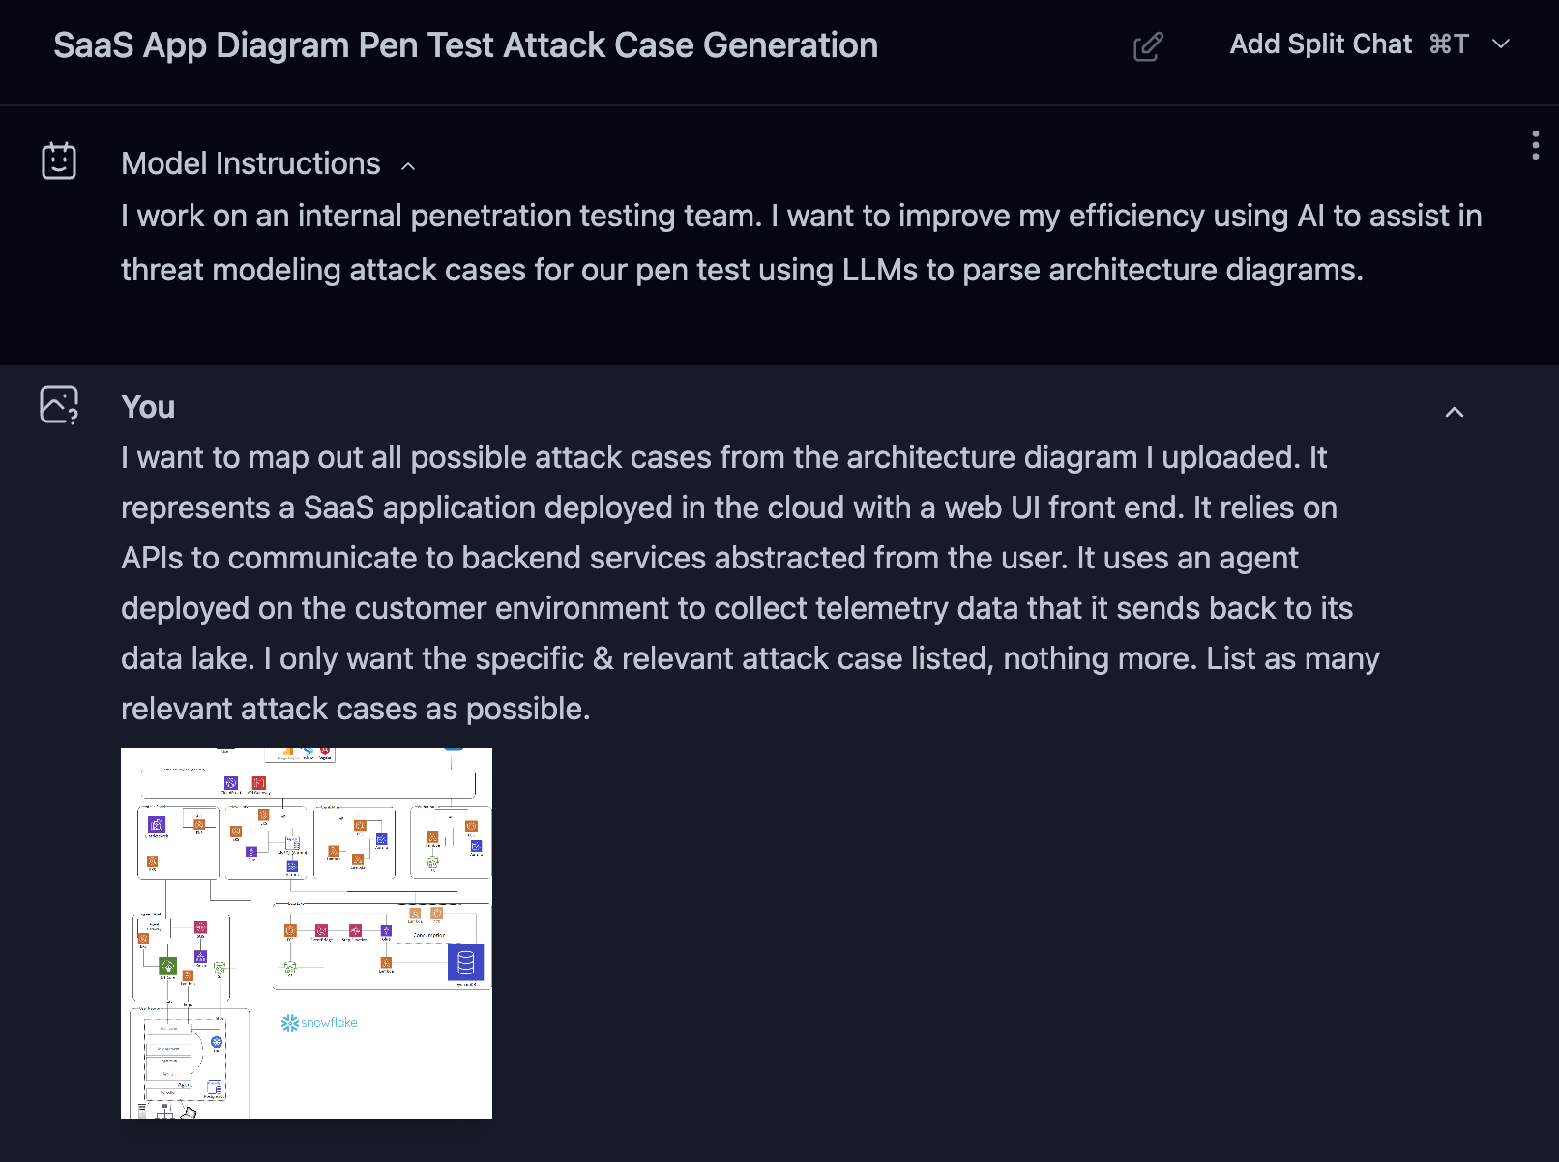
Pen Test Modeling: Prompt
Notes:
I am executing a pen test against the SaaS application represented in the diagram attached. I want to identify all vulnerabilities. I want vulnerabilities in the web front end as well as the cloud control plane components listed. Dependencies in components (authentication, client-side add-ons, etc) are also in-scope. List me all relevant attack cases for this application--be thorough without significant verbosity (I don't want details, only attack case category itself). Be specific, I do not want generic "Authentication Bypass", "Privilege Escalation", "Lateral Movement", etc. I want specifics based on the relevant components displayed in the diagram

Slide 36
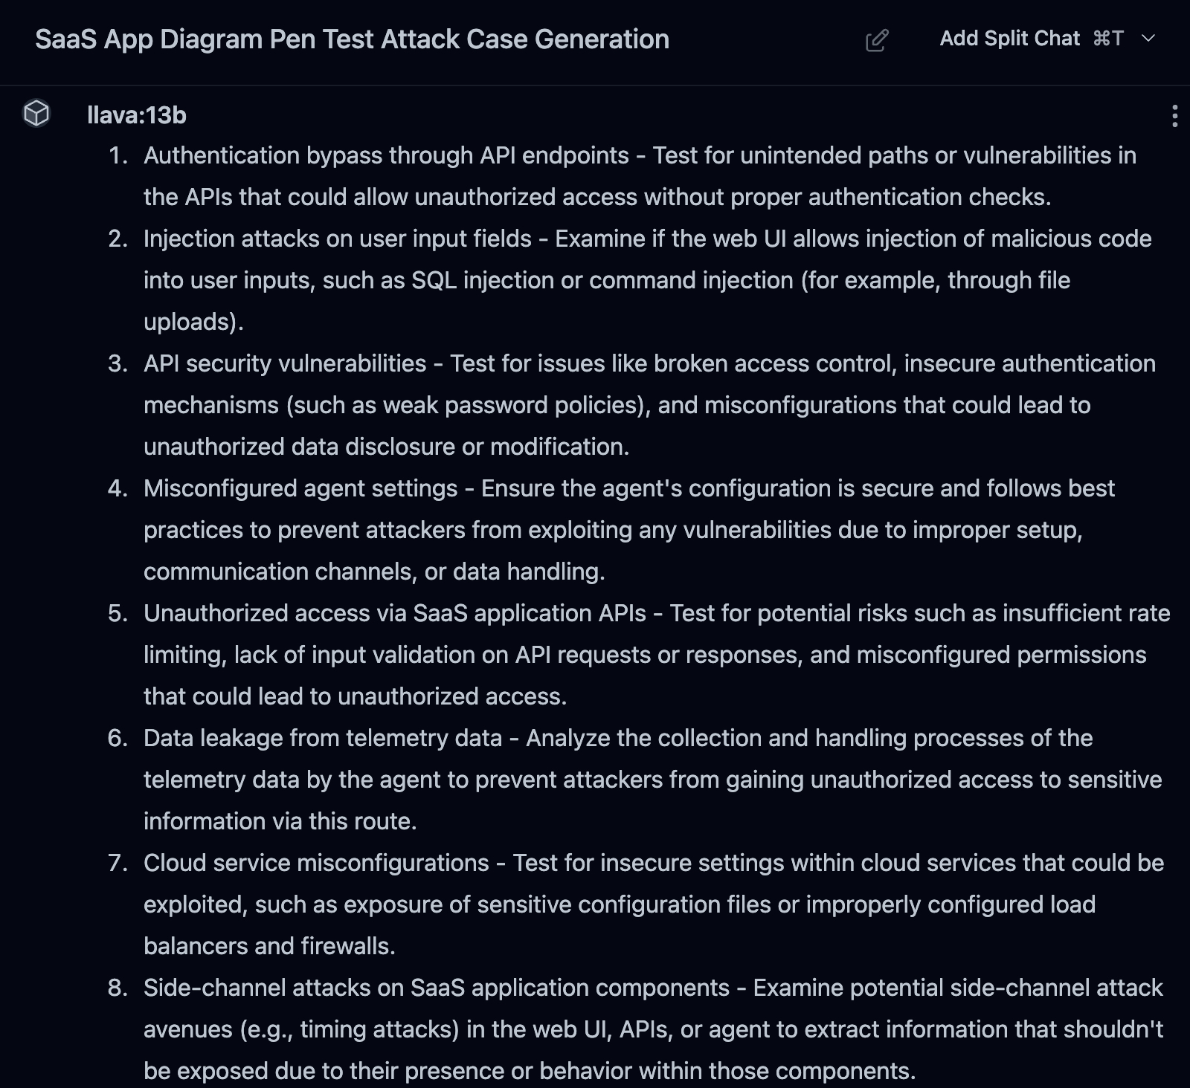
Pen Test Modeling: Initial Result (1)

Slide 37
Pen Test Modeling: Initial Result (2)

Slide 38

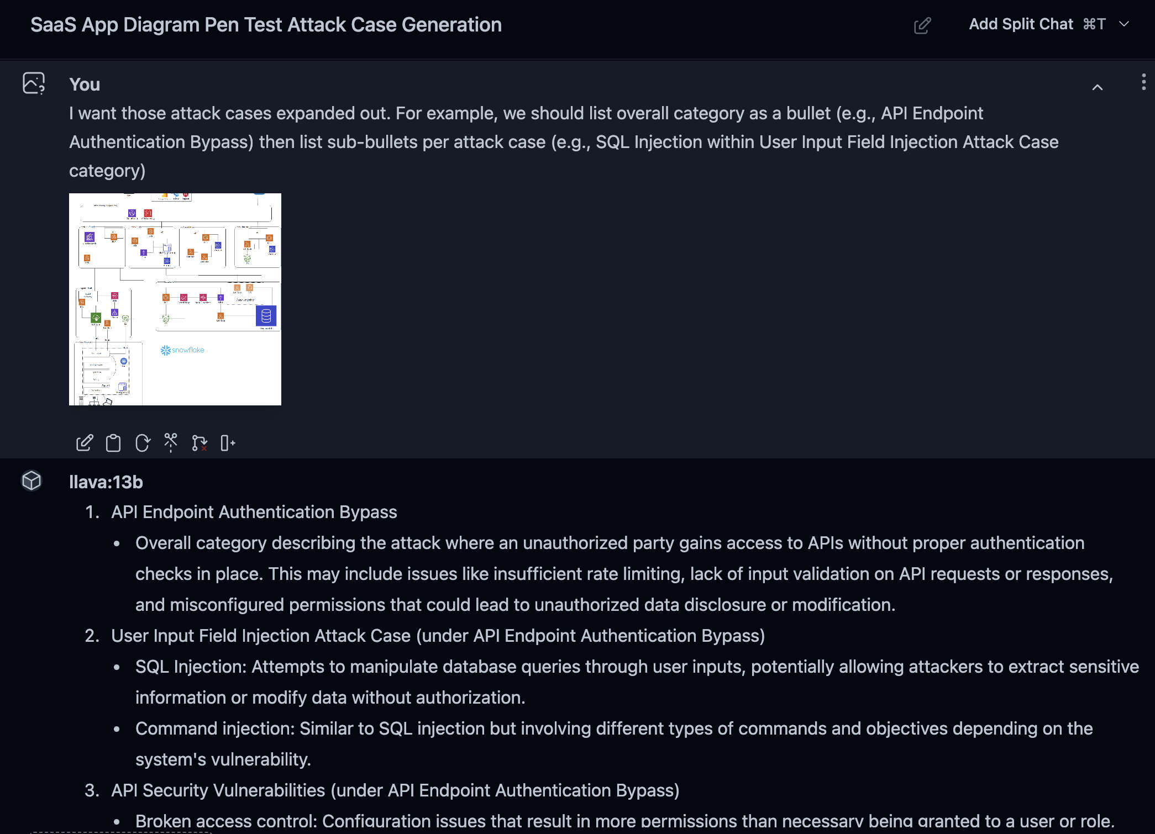
Pen Test Modeling: Prompt Tuning
Notes:
I want those attack cases expanded out. For example, we should list overall category as a bullet (e.g., XXXXX, XXXX) then list sub-bullets per attack case. I want to show the MITRE ATT&CK alignment.

Slide 39
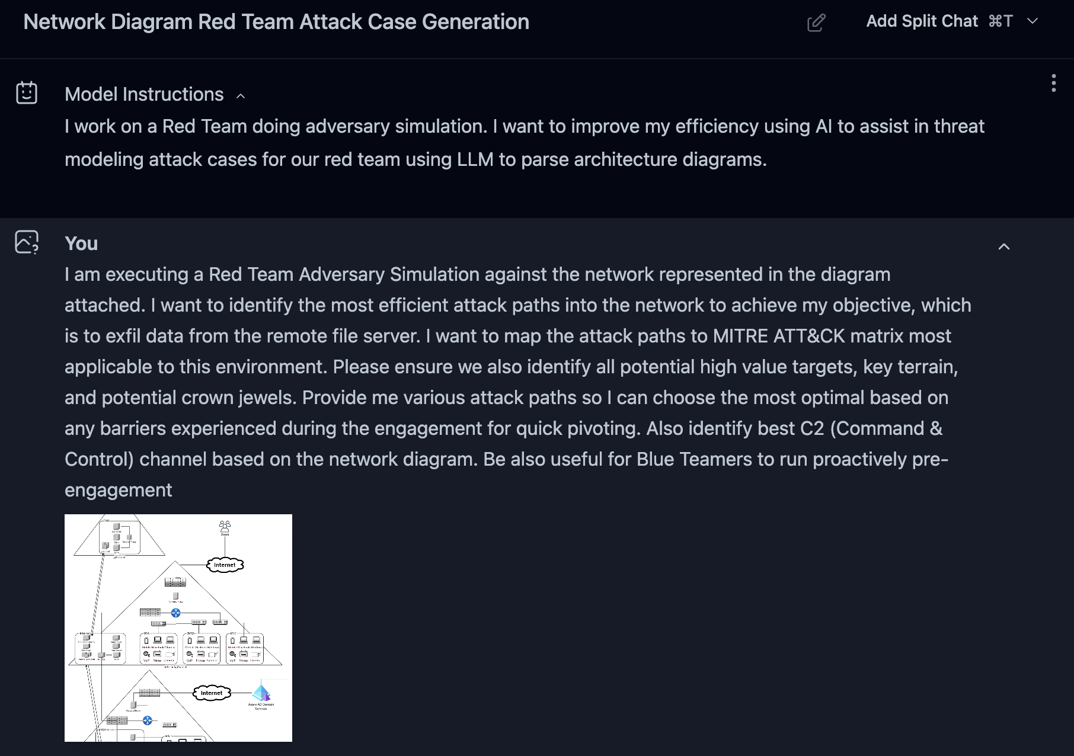
Red Team Modeling: Prompt
Notes:
I am executing a Red Team Adversary Simulation against the network represented in the diagram attached. I want to identify the most efficient attack paths into the network to achieve my objective, which is to exfil data from the remote file server. I want to map the attack paths to MITRE ATT&CK matrix most applicable to this environment. Please ensure we also identify all potential high value targets, key terrain, and potential crown jewels. Provide me various attack paths so I can choose the most optimal based on any barriers experienced during the engagement for quick pivoting. Also identify best C2 (Command & Control) channel based on the network diagram.
Be also useful for Blue Teamers to run proactively pre-engagement

Slide 40
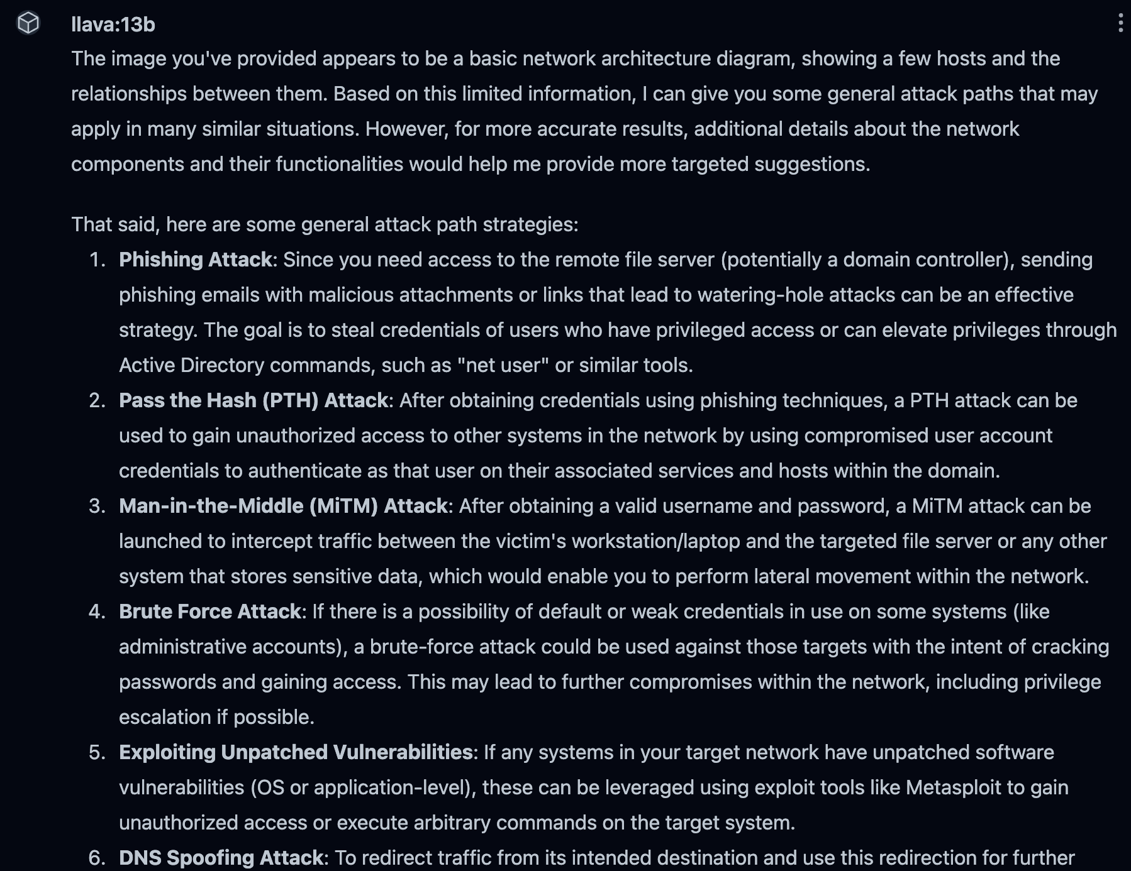
Red Team Modeling: Initial Results

Slide 41
Red Team Modeling: Initial Results

Slide 42
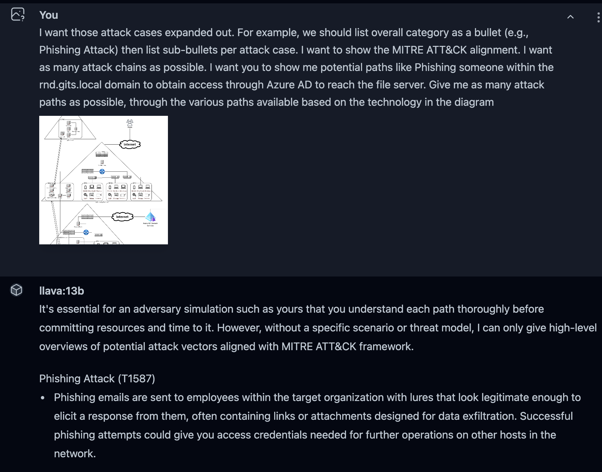
Red Team Modeling: Tuning
Notes:
I want those attack cases expanded out. For example, we should list overall category as a bullet (e.g., Phishing Attack) then list sub-bullets per attack case. I want to show the MITRE ATT&CK alignment. I want as many attack chains as possible. I want you to show me potential paths like Phishing someone within the rnd.gits.local domain to obtain access through Azure AD to reach the file server. Give me as many attack paths as possible, through the various paths available based on the technology in the diagram

Slide 43


Hybrid approach
Public LLM + Private LLM Approach
Feed “Dummy” Diagram into ChatGPT
Have it create attack test cases
Feed ChatGPT results LLaVa input
Example:
This is output from ChatGPT that matches closely what I want. Create test cases from the diagram that resembles its structure & depth.
Notes:
Run another prompt to see if results are better

Slide 44

Summary of results
chatGPT-4o
Very accurate test cases
Well-defined Red Team Attack Paths
Defined appropriate C2 Channels
Little tuning required
LLaVa 13B
Did not structure results as hoped
Required additional prompting
Secondary results promising but lacked the desired depth
Requires more tuning

Slide 45

LLaVa Threat Modeling Verdict
Results of threat modeling through quantized LLaVa deployment were relatively good & would likely be significantly better when using Full-Precision or Floating-Point Model deployments.

Slide 46


Contributors & GRATITUDE
Nadhem Al-Fardan
Darren Shu
Omar Santos
Thomas Tusia
Don Mills
Trevor Sharpe
Chris Frighelis
Matthew Adams
Jason Ostrom

Slide 47


FIN

